Slide 1


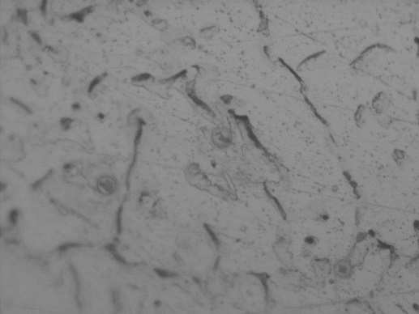
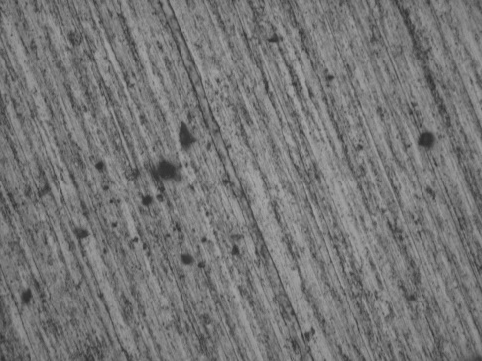
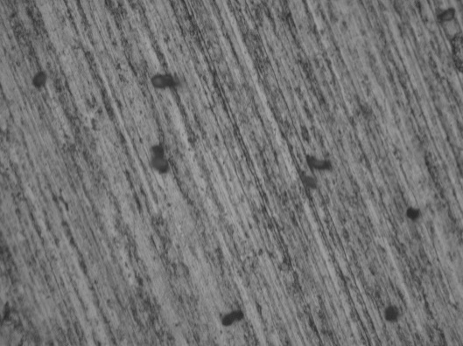
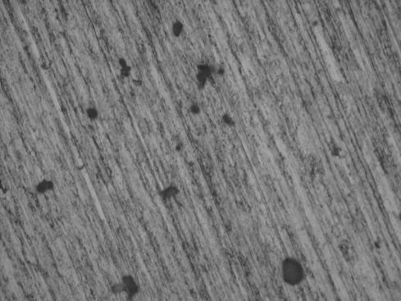
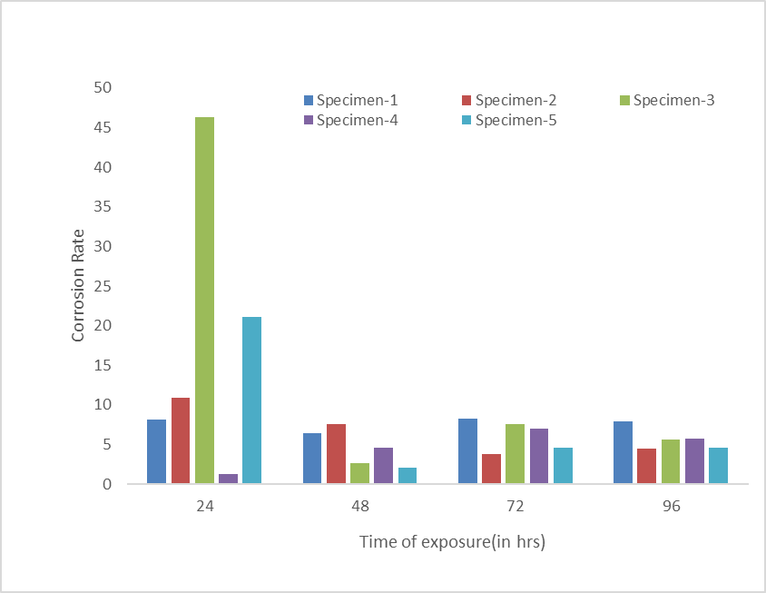
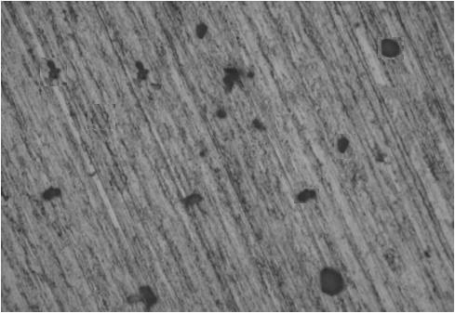
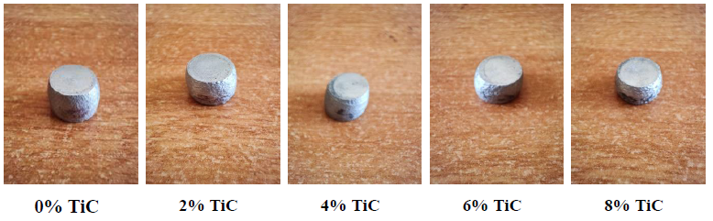
Technical Project Exhibition on
Microstructural And Corrosion Behaviour Of Al-2024/Sic/Cenosphere Hybrid Metal Matrix Composites
Bablu Kumar Yadav, Guddu Kumar Yadav , Roshan Kumar Ranjan , Deepak B R, Mr. Balaji Y S
Department of Mechanical Engineering
Nagarjuna College of Engineering and Technology
Introduction
Results
Salt Spray Test
Composite materials are playing vital and major role in research and development of various engineering and aeronautical sectors because of obtaining superior properties such as higher specific strength, high hardness, high wear resistance, high thermal resistance and low density. Specifically aluminum metal matrix composites have preferred in aeronautics, marine and automotive industries for obtaining best result of mechanical properties.
Evaluation of Microstructure:-
SL NO | Material | Initial weight(grams) | Final weight(grams)
1 | AL-2024 (Pure) | 33 | 32
2 | AL-2024,5% Cenosphere & 2% Sic | 34 | 34
3 | AL-2024,5% Cenosphere & 4% Sic | 33 | 32
4 | AL-2024,5% Cenosphere & 6% Sic | 34 | 33
5 | AL-2024,5% Cenosphere & 8% Sic | 30 | 31
0%SiC
2% SiC
Salt Immersion Test
4% SiC
6% SiC
8% SiC
Compression Test:-
Scope For Future Work
Further Investigation can be carried out
By different manufacturing processes like powder metallurgy route and Spray casting to analyze for better properties.
By increasing the percentage of Cenosphere which was kept as 5%constant in present investigation.
By enhancing the tribological properties of the composite composition mixture by heat treatment processes.
Scope of the Project
In the project Al 2024 reinforced with varying weight percentages of Sic and constant weight percentage of Cenosphere were considered to improve:-
the mechanical properties of Al2024 based metal matrix alloy. And
Corrosion Behaviour
Load v/s Displacement of Al-2024
Load v/s Displacement of Al-2024 +2% SiC+5% Cenosphere
Load v/s Displacement of Al-2024 +4% SiC+5% Cenosphere
Load v/s Displacement of Al-2024 +6% SiC+5% Cenosphere
Methodology
Compression strength
Conclusion
Images from optical microscope of composites of various compositions were obtained, where we can clearly observe uniform distribution of particles, grain boundaries and little porosities showing good quality casting.
The Compression strength and Hardness increased with increase in weight fraction of Silicon carbide.
Prepared composites subjected to different test like salt immersion test, salt spray test and potentiodynamic polarization test showed significant improvement in corrosion resistance.
The Flow Chart explains the procedure followed in the project:-.
Figure : Compression Strength v/s % of reinforcement
Load v/s Displacement of Al-2024 +8% SiC+5% Cenosphere
% Reinforcement
Specimen | Ultimate Load (KN) | Displacement (mm) | Compression Strength (KN/mm2)
Al 2024 | 81.9 | 6 | 0.167
Al 2024+ 2% SiC+ 5% Cenosphere | 77.88 | 7.4 | 0.587
Al 2024+ 4% SiC+ 5% Cenosphere | 78.3 | 6 | 0.59
Al 2024+ 6% SiC+ 5% Cenosphere | 83.86 | 5.2 | 0.632
Al 2024+ 8% SiC+ 5% Cenosphere | 86.82 | 6 | 0.654
Literature Review
Selection of Matrix & Reinforcement Materials
Manufacturing of Metal matrix composites by Stir Casting Method
Hardness Test
Material | Trail No. | Force Applied in Kgs | Time in Sec | Diameter of Indentation d (mm) | Average diameter of Indentation | BHN(Kgf/mm²)
Al 2024 +0% SiC +5%Cenosphere | 1 2 3 | 187.5 | 10 | 2.1 2.0 2.0 | 2.03 | 45.87
Al 2024 + 2% SiC+ 5%Cenosphere | 1 2 3 | 187.5 | 10 | 2.0 2.1 2.1 | 2.06 | 44.06
Al 2024 + 4% SiC+ 5%Cenosphere | 1 2 3 | 187.5 | 10 | 2.0 2.0 2.0 | 2.0 | 47.74
Al 2024 + 6% SiC+ 5%Cenosphere | 1 2 3 | 187.5 | 10 | 1.8 1.6 2.0 | 1.8 | 62.40
Al 2024 + 8% SiC+ 5%Cenosphere | 1 2 3 | 187.5 | 10 | 1.5 2.0 2.0 | 1.83 | 59.92
Determination of Mechanical Properties of Prepared Composites
Specimen Characterization
Corrosion Studies
Tensile Test
Hardness Test
Wear Test
Optical Microscope
SEM
Salt Immersion Test
Salt Spray Test

